Slide 1
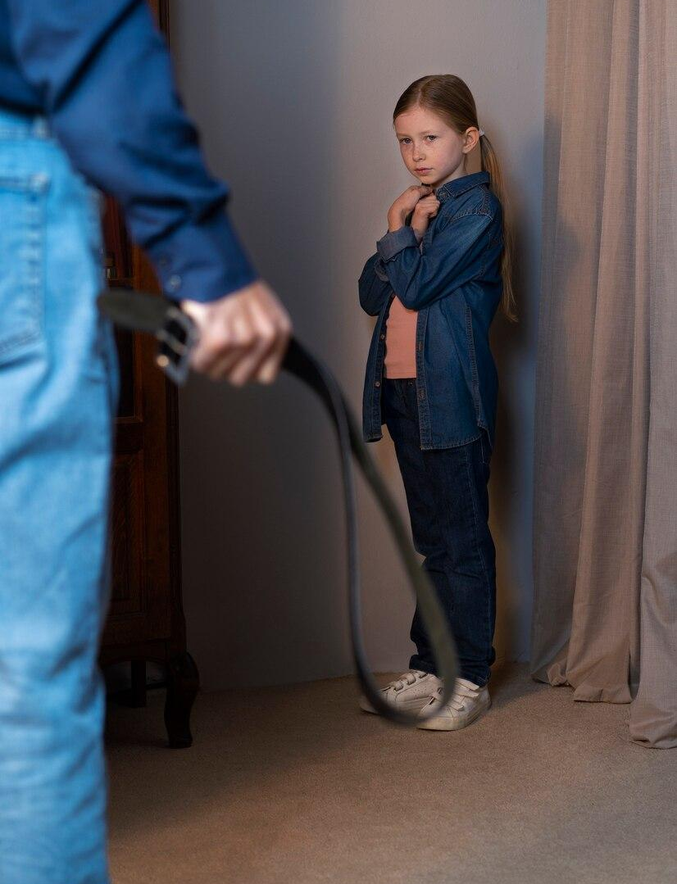
Action and Prevention of Child Abuse

Slide 2
Table of contents
01
Law for the protection of children against violence
02
What is child abuse?
03
How to prevent and act against child abuse?
04
Sources and links of interest

Slide 3
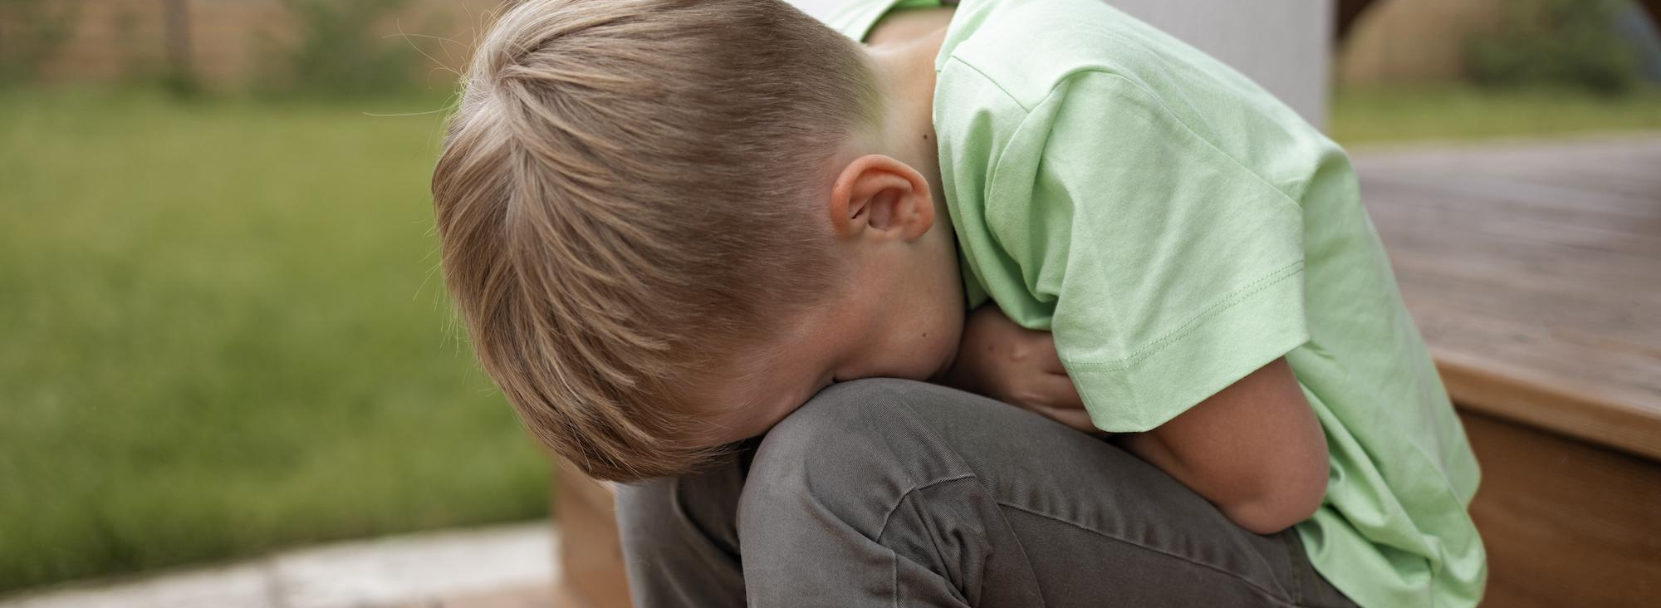
01
Law for the protection of children against violence

Slide 4
Regulatory framework for children's rights
The Child Abuse Prevention and Treatment Act (CAPTA) was first enacted on 1974 and has undergone revisions up to the year 2019
Federal funding and guidance are provided to States by CAPTA to support prevention, assessment, investigation, prosecution, and treatment activities. CAPTA also offers grants for demonstration programs and projects to public agencies and non-profit organizations, including Indian Tribes and Tribal organizations

Slide 5
Strategic areas, objectives and
lines of action
1 | Knowledge of the reality of violence against children | To guarantee knowledge of the reality of violence against children and adolescents, necessary to develop effective action strategies
2 | Culture of fair treatment and zero tolerance to violence | To create a culture of fair treatment and zero tolerance of violence against children
3 | Safe spaces | Ensure that the environments where children and adolescents live and interact are safe environments
Fuente: Espirales Consultoría de Infancia (2022)

Slide 6
Strategic areas, objectives and
lines of action
4 | Specialized multidisciplinary care | To guarantee specialized and multidisciplinary care for children and adolescents who have suffered or have been subjected to violence
5 | A multidisciplinary, coordinated and effective approach to of violence | Multidisciplinary, coordinated and effective approach to violence against children and adolescents
Fuente: Espirales Consultoría de Infancia (2022)

Slide 7
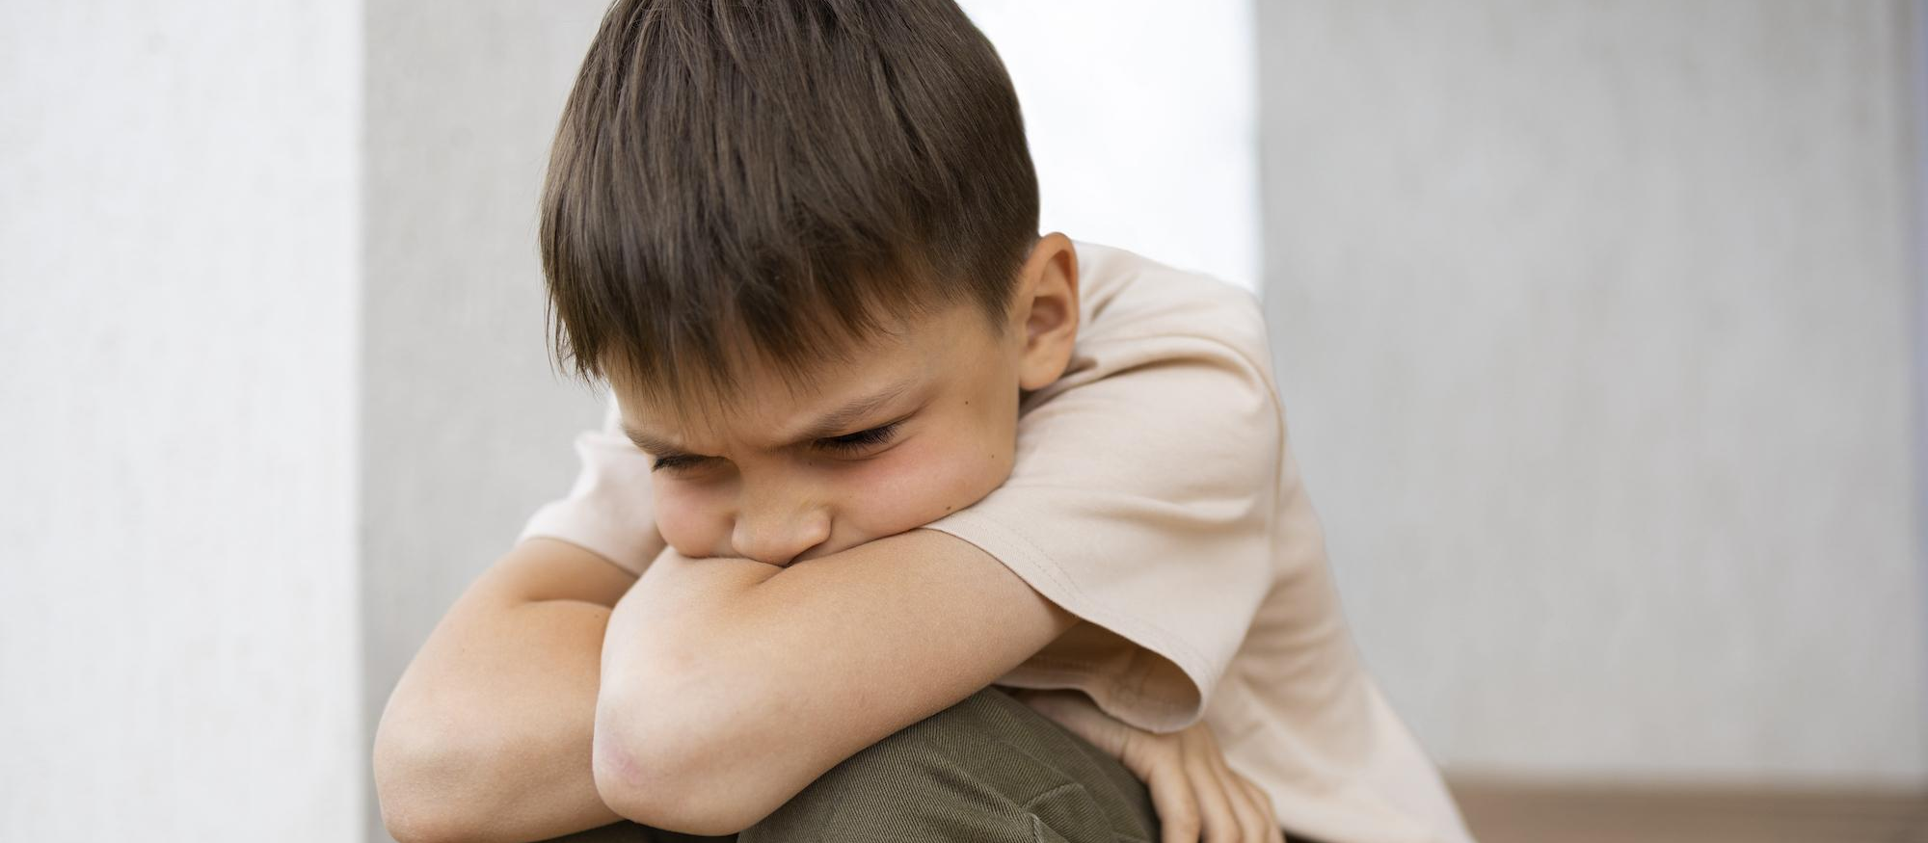
02
What is
child abuse?

Slide 8
Definition and types of
child abuse
The convention on the rights of the child in its article 19 defines child maltreatment as follows (Espirales Childhood Consultancy, 2022):
All forms of physical or mental violence, injury or abuse, neglect or negligent treatment, maltreatment or exploitation, including sexual abuse, while in the care of parent(s), legal guardian(s) or any other person who has the care of the child

Slide 9
Physical abuse
Sexual abuse
Neglect
Psychological abuse
From this we can break down child maltreatment into the following types:
All of them violate some of the fundamental rights of children, i.e., the biological, cognitive, emotional or social needs of the child

Slide 10
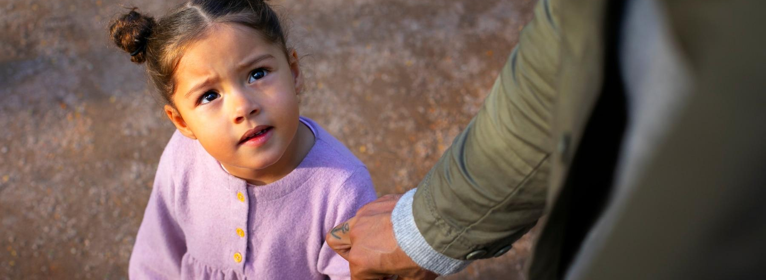
03
How to prevent
and act against
child abuse?

Slide 11
Prevention
and action protocols
The first step to know if we are facing a case of child abuse is to know the warning signs that indicate possible cases of abuse
To this end, awareness and prevention protocols are essential. They facilitate the knowledge on the part of families, teachers and the educational community of:
Signs of abuse
How we can act

Slide 12
Prevention and action protocols
When we know that we are dealing with a case of child abuse, it is important to get information about prevention and action protocols
One example would be:
Gathering information with the child
Communication of the facts to the teaching team
Protection of the child by contacting the relevant authorities
Official notification

Slide 13
Prevention and action protocols
The most important thing in this whole process is:
Treat the situation with confidentiality
Access information on the protocols in your community
Contact the relevant entities according to the protocol
Report the situation

Slide 14

04
Sources and links
of interest

Slide 15
Sources
Espirales Consultoría de Infancia (2022). Estrategia de erradicación de la violencia sobre la infancia y adolescencia. Ministerio de Derechos Sociales y Agenda 2030 Secretaría General Técnica. // Link
Child Welfare Information Gateway. (2019). About CAPTA: A legislative history. Washington, DC: U.S. Department of Health and Human Services, Children’s Bureau. // Link
Centro Documental Virtual sobre Prevención del Maltrato Infantil y Adolescente, de la Federación de Asociaciones para la Prevención del Maltrato Infantil (FAPMI). // Link

Slide 16
Thanks!
Any questions?
youremail@freepik.com
+91 620 421 838
yourwebpage.com
Please keep this slide as attribution

Slide 17
Alternative resources
Here’s an assortment of alternative resources whose style fits that of this template:
Fotos
Full shot kid being bullied in classroom
Side view sad girl at school with laptop
Side view girl getting bullied at school
High angle sad teenager at school
Sad teenager at school full shot

Slide 18
Resources
Did you like the resources on this template? Get them for free at our other websites:
Fotos
Young child suffering abuse by parent with belt
Close up on sad boy portrait
Close up on sad boy portrait II
Father spending time with his daughter outdoors on father's day
Full shot sad teenager at school

Slide 19
Instructions for use
If you have a free account, in order to use this template, you must credit Slidesgo by keeping the Thanks slide. Please refer to the next slide to read the instructions for premium users.
As a Free user, you are allowed to:
Modify this template.
Use it for both personal and commercial projects.
You are not allowed to:
Sublicense, sell or rent any of Slidesgo Content (or a modified version of Slidesgo Content).
Distribute Slidesgo Content unless it has been expressly authorized by Slidesgo.
Include Slidesgo Content in an online or offline database or file.
Offer Slidesgo templates (or modified versions of Slidesgo templates) for download.
Acquire the copyright of Slidesgo Content.
For more information about editing slides, please read our FAQs or visit our blog:
https://slidesgo.com/faqs and https://slidesgo.com/slidesgo-school

Slide 20
Instructions for use (premium users)
As a Premium user, you can use this template without attributing Slidesgo or keeping the "Thanks" slide.
You are allowed to:
Modify this template.
Use it for both personal and commercial purposes.
Hide or delete the “Thanks” slide and the mention to Slidesgo in the credits.
Share this template in an editable format with people who are not part of your team.
You are not allowed to:
Sublicense, sell or rent this Slidesgo Template (or a modified version of this Slidesgo Template).
Distribute this Slidesgo Template (or a modified version of this Slidesgo Template) or include it in a database or in any other product or service that offers downloadable images, icons or presentations that may be subject to distribution or resale.
Use any of the elements that are part of this Slidesgo Template in an isolated and separated way from this Template.
Register any of the elements that are part of this template as a trademark or logo, or register it as a work in an intellectual property registry or similar.
For more information about editing slides, please read our FAQs or visit our blog:
https://slidesgo.com/faqs and https://slidesgo.com/slidesgo-school

Slide 21
Fonts & colors used
This presentation has been made using the following fonts:
Open Sans
(https://fonts.google.com/specimen/Fira+Sans+Extra+Condensed)
#313131
#cfcfff
#f9b341
#ffffff

Slide 22





Storyset
Create your Story with our illustrated concepts. Choose the style you like the most, edit its colors, pick the background and layers you want to show and bring them to life with the animator panel! It will boost your presentation. Check out how it works.
Pana
Amico
Bro
Rafiki
Cuate

Slide 23
Use our editable graphic resources...
You can easily resize these resources without losing quality. To change the color, just ungroup the resource and click on the object you want to change. Then, click on the paint bucket and select the color you want. Group the resource again when you’re done. You can also look for more infographics on Slidesgo.

Slide 26
JANUARY
FEBRUARY
MARCH
APRIL
MAY
JUNE
PHASE 1
Task 1
Task 2
PHASE 2
Task 1
Task 2
JANUARY
FEBRUARY
MARCH
APRIL
PHASE 1
Task 1
Task 2

Slide 29
...and our sets of editable icons
You can resize these icons without losing quality.
You can change the stroke and fill color; just select the icon and click on the paint bucket/pen.
In Google Slides, you can also use Flaticon’s extension, allowing you to customize and add even more icons.

Slide 30
Educational Icons
Medical Icons

Slide 31
Business Icons
Teamwork Icons

Slide 32
Help & Support Icons
Avatar Icons

Slide 33
Creative Process Icons
Performing Arts Icons

Slide 34
Nature Icons

Slide 35
SEO & Marketing Icons

Slide 36


